Slide 1
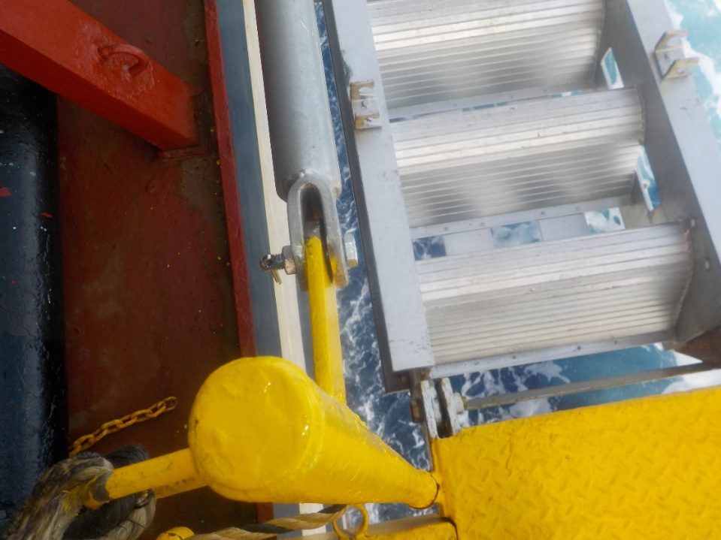
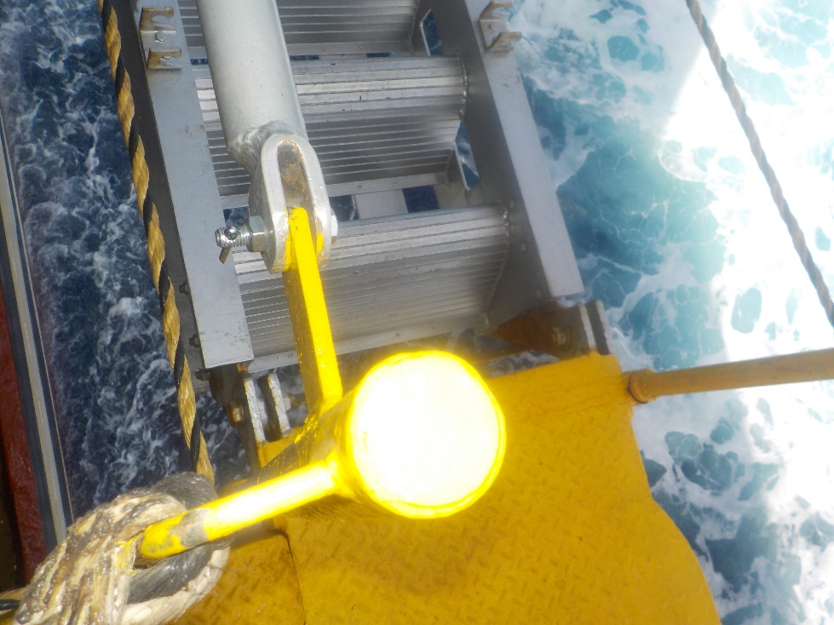
MSC PAOLA
Pilot Boarding Arrangement
Combination ladder railing secured with nut and bolt.

Slide 2
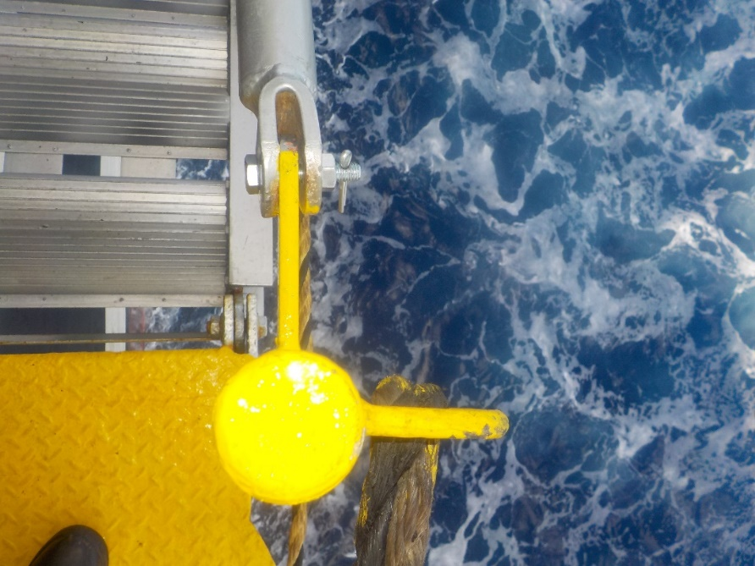
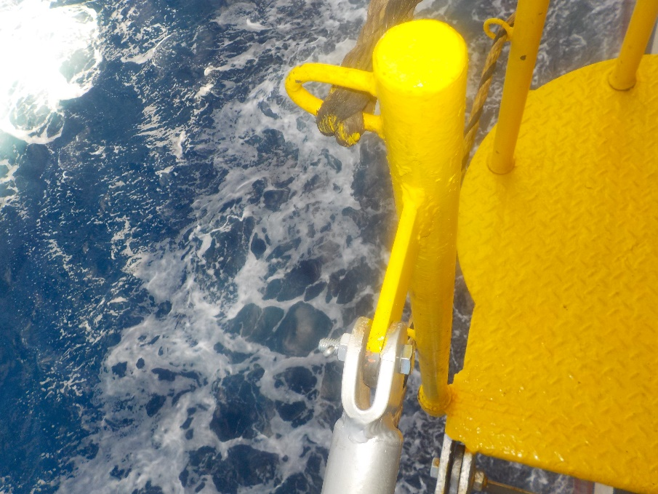
MSC PAOLA
Pilot Boarding Arrangement
Combination ladder railing secured with nut and bolt.

Slide 3
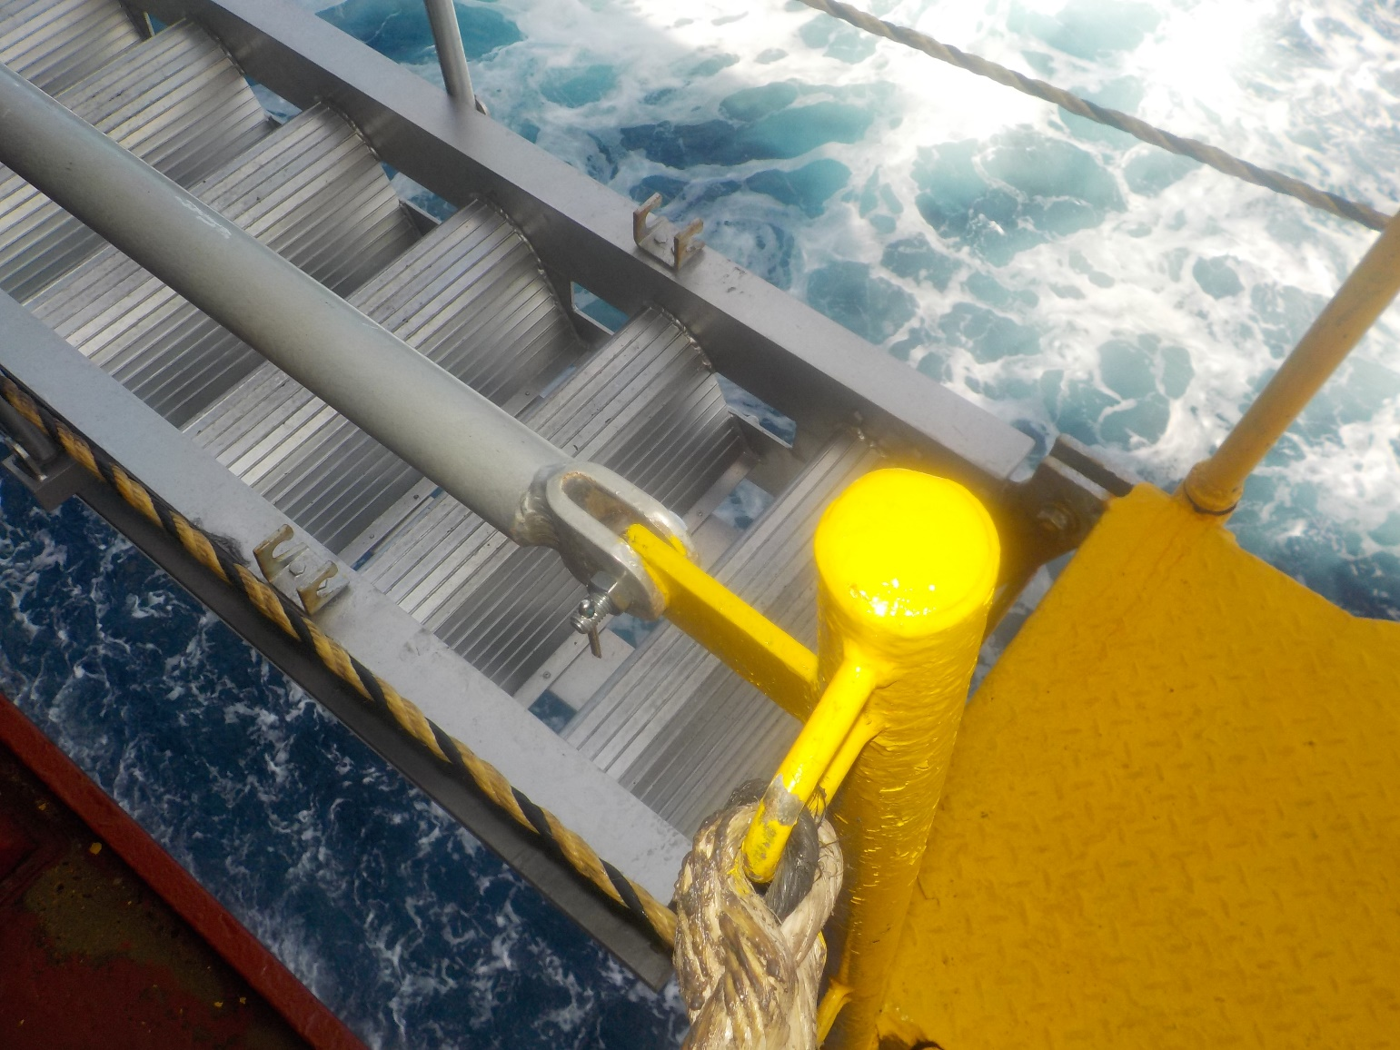
MSC PAOLA
Pilot Boarding Arrangement
Combination ladder railing secured with nut and bolt.

Slide 4
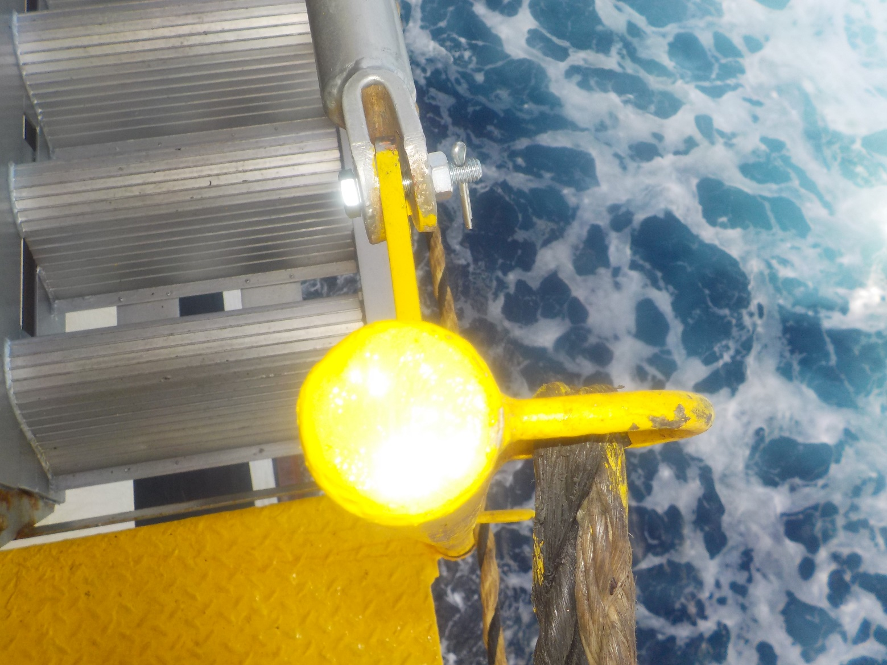
MSC PAOLA
Pilot Boarding Arrangement
Combination ladder railing secured with nut and bolt.

